Slide 1

EECE1001 Basic Electrical and Electronics Engineering Unit-V Operational Amplifiers

Slide 2
contents
Introduction
Ideal OP-AMP
Inverting Configuration
Non-inverting Configuration
Voltage follower
Adder or Summing Amplifier
Subtractor or Difference Amplifier
Difference amplifiers(Single Op-amp & two Op-amps)
Op-amp as Integrator
Op-amp as Differentiator
Op-Amp filter circuits.

Slide 3
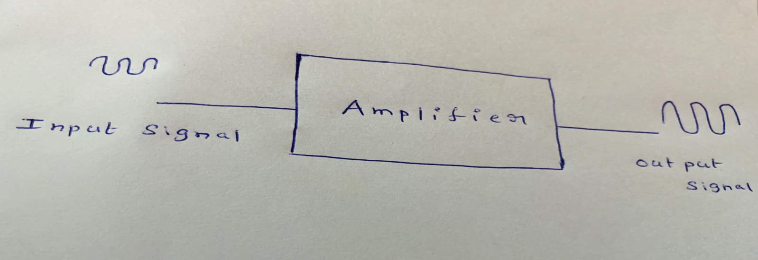
introduction
An operational amplifier is an Amplifier which amplifies the signal and member of Linear integrated circuits.
It is a high gain, negative feedback amplifier.
It can perform mathematical operations such as addition, subtraction, integration and differentiation.
It is used in voltage regulators, oscillator circuits, pulse generators, comparators, Analog to Digital and Digital to Analog converters, analog computers etc.
It is popularly known as OP-AMP.
It can amplify both d.c and a.c input signals.

Slide 4
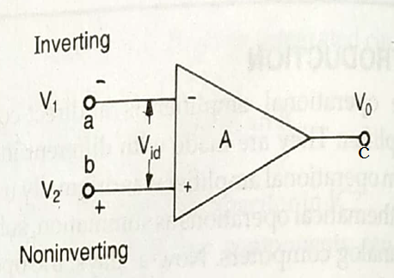
Op-Amp Symbol
(+) or ‘b’ is non-inverting terminal
(-) or ‘a’ is inverting terminal
‘a’ and ‘b’ input terminals
‘c’ output terminals
Positive voltage input V₂ is applied to terminal ‘b’ and negative voltage input V₁ is applied to terminal ‘a’.
Output voltage V₀ = A(V_{id}) = A (V₂-V₁)
where A is the open loop gain of the amplifier

Slide 5
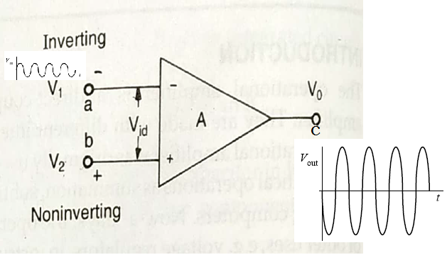
The Ideal Op-Amp (Inverting)
Output voltage V₀ = A(V_{id}) = A (0-V₁) = -AV₁

Slide 6
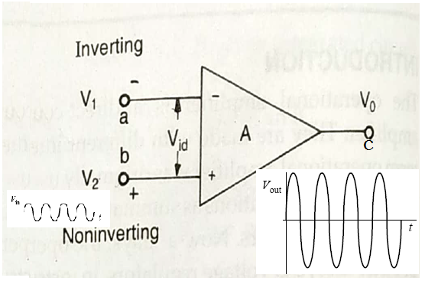
The Ideal Op-Amp (Non inverting)
Output voltage V₀ = A(V_{id}) = A (V₂ - 0) = AV₂

Slide 7
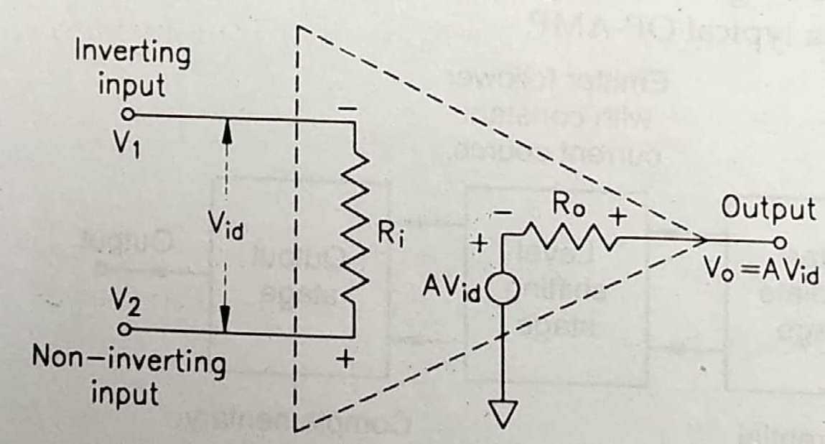
The Ideal Op-Amp: equivalent circuit
Equivalent circuit is helpful in analyzing the operating principle of OP-AMP and in observing effects of feedback.
R_{i} is the input resistance appearing between inverting and non-inverting terminals.
R₀ is the output resistance which is Thevenin equivalent resistance looking back from output terminals of OP-AMP.
‘AV_{id}’ is the equivalent Thevenin voltage source.

Slide 8
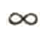
The Ideal Op-Amp: characteristics
Ideal OP-AMP has following characteristics:
An infinite voltage gain. i.e. A =
An infinite bandwidth. i.e., any frequency signal ranging 0 to
Hz can be amplified without any distortion.
Infinite input resistance. i.e., R_{i} = . Hence, input current is zero and no loading effect. OP-AMP is a voltage-controlled device.
Zero output resistance. i.e., R₀ = 0. Hence, V₀ is independent of the output resistance.
When input signal voltage is zero, the output signal will also be zero.
Common mode rejection ratio (CMRR)is infinite.
Infinite slew rate. i.e., change in output voltage occurs simultaneously with the input voltage changes.

Slide 9
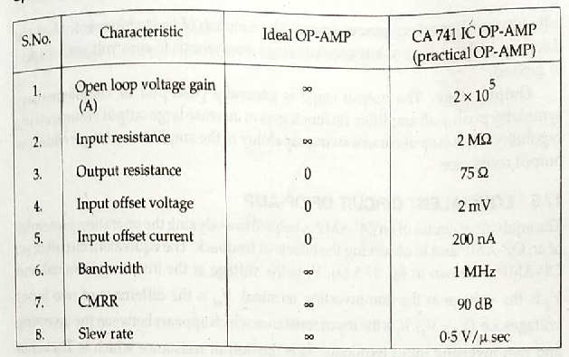
The Ideal Op-Amp: characteristics

Slide 10
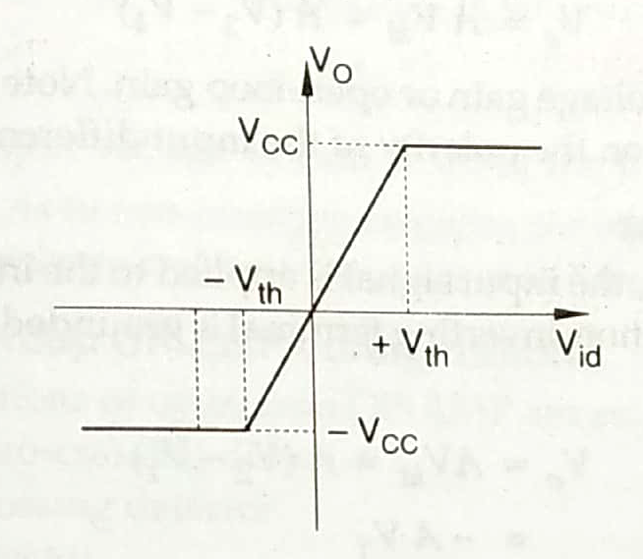
The Ideal Op-Amp: Transfer characteristics
Voltage transfer characteristic curve is drawn between input (V_{id}) and output (V₀) voltages.
Saturation of output voltage takes place once the differential input voltage ‘V_{id}’ reaches a threshold voltage ‘V_{th}’.
The saturation voltage is approximately equal to supply voltage for all practical considerations.
Slope of the curve represents the gain ‘A’.

Slide 11
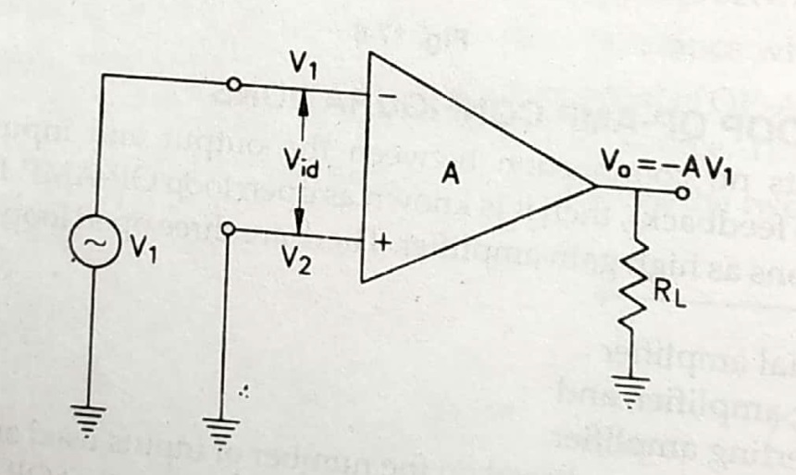
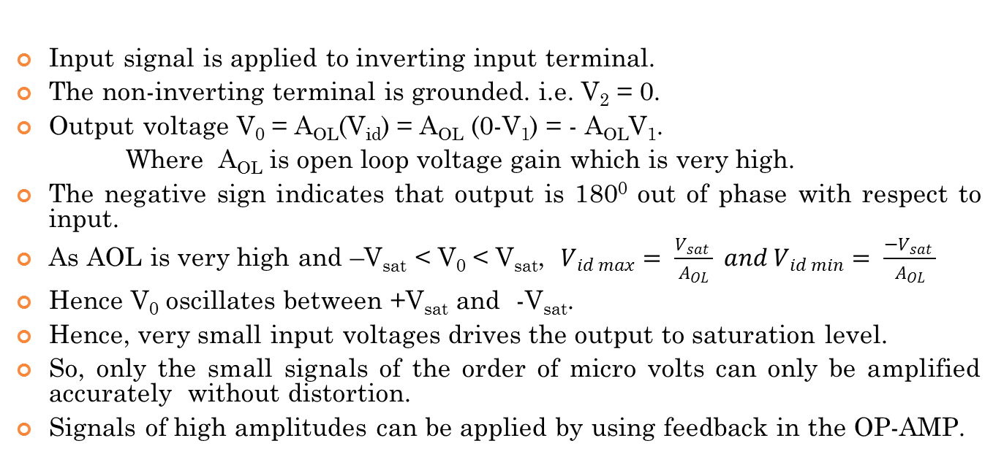
The Inverting Configuration: Open Loop
Input signal is applied to inverting input terminal.
The non-inverting terminal is grounded. i.e. V₂ = 0.
Output voltage V₀ = A_{OL}(V_{id}) = A_{OL} (0-V₁) = - A_{OL}V₁.
Where A_{OL} is open loop voltage gain which is very high.
The negative sign indicates that output is 180⁰ out of phase with respect to input.
As AOL is very high and –V_{sat}< V₀<V_{sat}, $V_{id max}= \frac{V_{sat} }{A_{OL}} and V_{id min}= \frac{−V_{sat} }{A_{OL}}$
Hence V₀ oscillates between +V_{sat} and -V_{sat}.
Hence, very small input voltages drives the output to saturation level.
So, only the small signals of the order of micro volts can only be amplified accurately without distortion.
Signals of high amplitudes can be applied by using feedback in the OP-AMP.

Slide 12
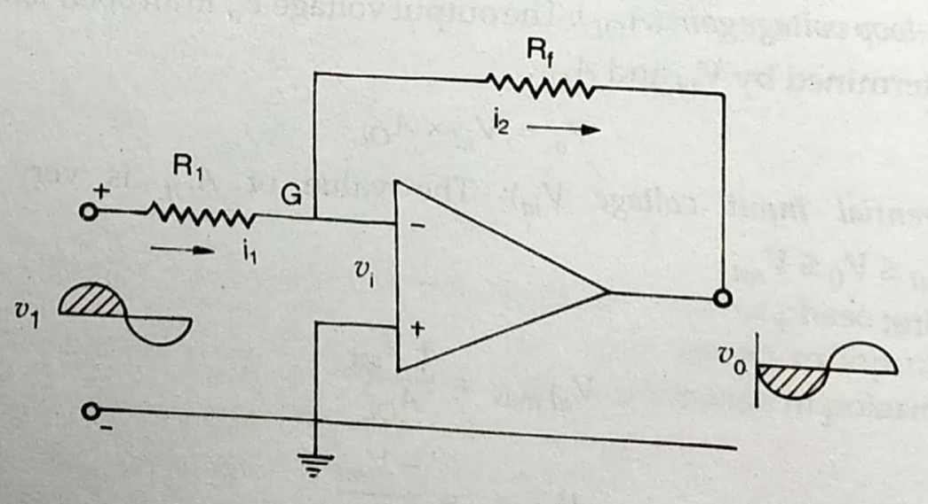
The Inverting Configuration: Closed Loop
Figure shows basic inverting amplifier with feedback resistance R_{f} . In this mode positive input terminal is grounded and the signal is applied to the negative terminal.
V₁ may be a d.c. or a.c. voltage signal with in the bandwidth of amplifier.
Output signal is fed back to the inverting input terminal through feedback resistance R_{f} .
The feedback current is algebraically added point G.
The point G, although not connected to ground, but is held virtually at ground potential irrespective of V₁ and V₀.

Slide 13
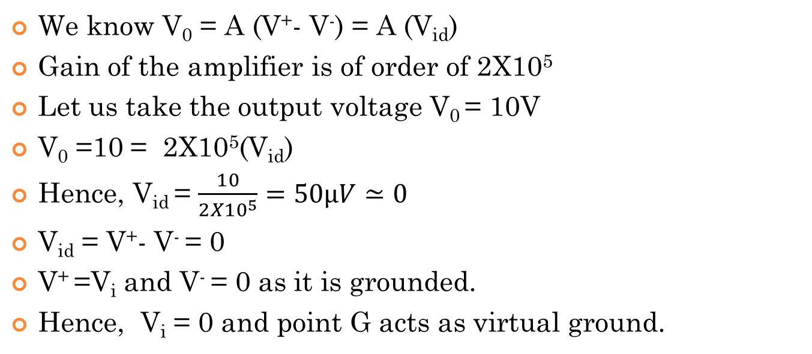
Concept of virtual ground
We know V₀ = A (V⁺- V⁻) = A (V_{id})
Gain of the amplifier is of order of 2X10⁵
Let us take the output voltage V₀ = 10V
V₀ =10 = 2X10⁵(V_{id})
Hence, V_{id} = $\frac{10}{{2X10}^{5}}=50μV≃0$
V_{id} = V⁺- V⁻ = 0
V⁺ =V_{i} and V⁻ = 0 as it is grounded.
Hence, V_{i} = 0 and point G acts as virtual ground.

Slide 14
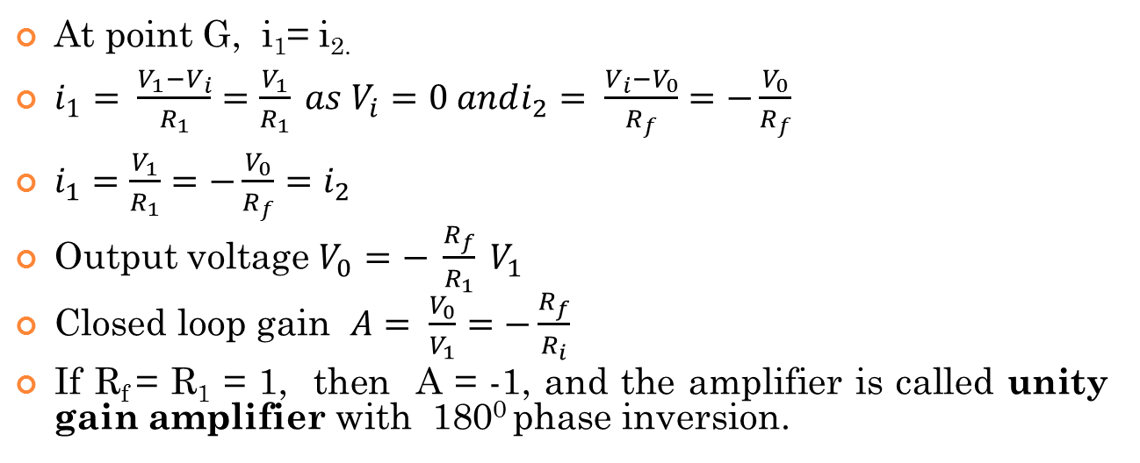
The Inverting Configuration: Closed Loop
At point G, i₁= i_{2.}
$i_{1}= \frac{V_{1}−V_{i}}{R_{1}}=\frac{V_{1}}{R_{1}} as V_{i}=0 andi_{2}= \frac{V_{i}−V_{0}}{R_{f}}=−\frac{V_{0}}{R_{f}}$
$i_{1}=\frac{V_{1}}{R_{1}}=−\frac{V_{0}}{R_{f}}=i_{2}$
Output voltage $V_{0}=− \frac{R_{f}}{R_{1}} V_{1}$
Closed loop gain $A= \frac{V_{0}}{V_{1}}=−\frac{R_{f}}{R_{i}}$
If R_{f}= R₁ = 1, then A = -1, and the amplifier is called unity gain amplifier with 180⁰ phase inversion.

Slide 15
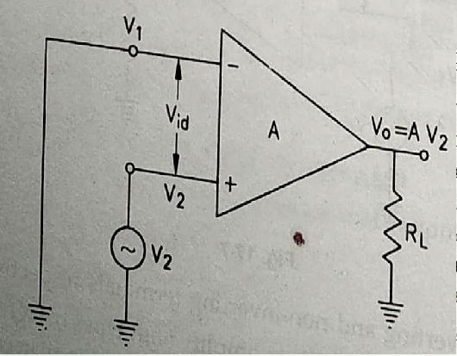
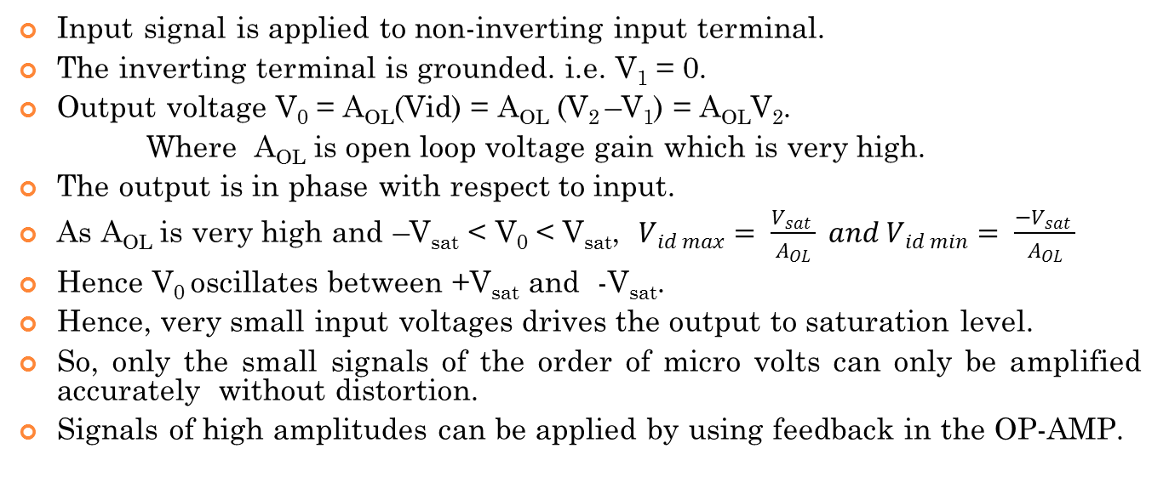
The Non-inverting Configuration: Open Loop
Input signal is applied to non-inverting input terminal.
The inverting terminal is grounded. i.e. V₁= 0.
Output voltage V₀ = A_{OL}(Vid) = A_{OL}(V₂ –V₁) = A_{OL}V₂.
Where A_{OL} is open loop voltage gain which is very high.
The output is in phase with respect to input.
As A_{OL} is very high and –V_{sat}< V₀<V_{sat}, $V_{id max}= \frac{V_{sat} }{A_{OL}} and V_{id min}= \frac{−V_{sat} }{A_{OL}}$
Hence V₀ oscillates between +V_{sat} and -V_{sat}.
Hence, very small input voltages drives the output to saturation level.
So, only the small signals of the order of micro volts can only be amplified accurately without distortion.
Signals of high amplitudes can be applied by using feedback in the OP-AMP.

Slide 16
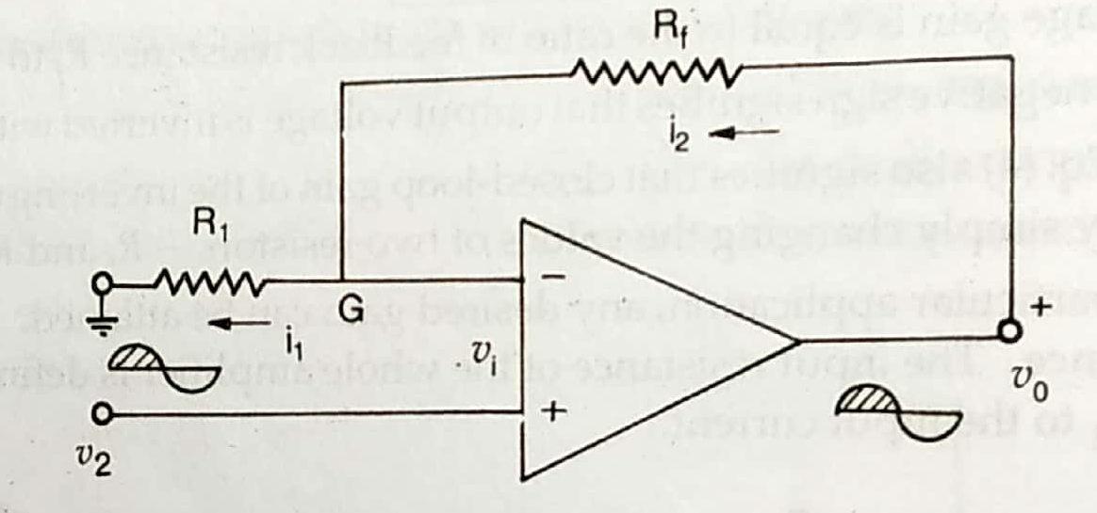
The Non-inverting Configuration: Closed Loop
Figure shows basic non-inverting amplifier with feedback resistance R_{f} . In this mode negative input terminal is grounded through R₁and the signal is applied to the positive terminal.
Output signal is fed back to the inverting input terminal through feedback resistance R_{f} .
The potential of point G, V_{i}= V⁺= V₂
The feedback current is algebraically added point G.
Voltage across R₁ is equal to V₂ and R_{f} is (V₀ –V₂).

Slide 17
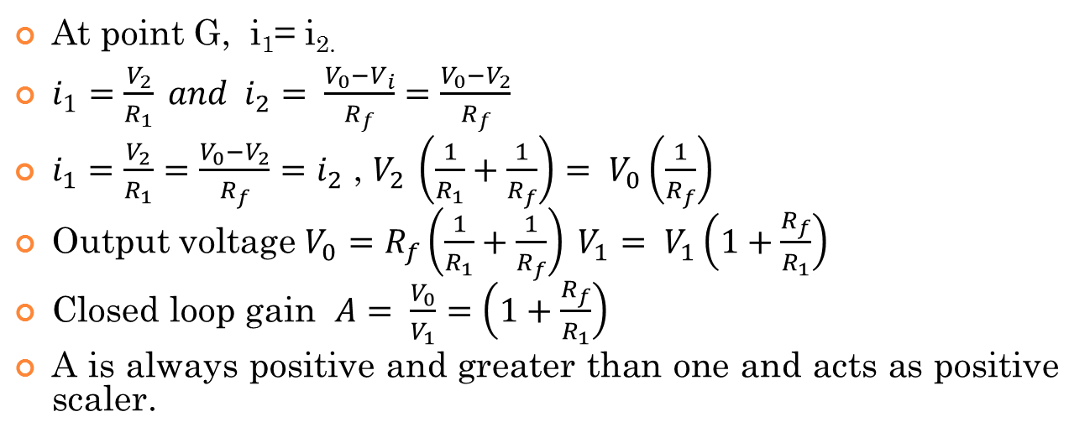
The Non-inverting Configuration: Closed Loop
At point G, i₁= i_{2.}
$i_{1}=\frac{V_{2}}{R_{1}} and{ i}_{2}= \frac{V_{0}−V_{i}}{R_{f}}=\frac{V_{0}−V_{2}}{R_{f}}$
$i_{1}=\frac{V_{2}}{R_{1}}=\frac{V_{0}−V_{2}}{R_{f}}=i_{2}$ , $V_{2 }\left(\frac{1}{R_{1}}+\frac{1}{R_{f}}\right)= V_{0}\left(\frac{1}{R_{f}}\right)$
Output voltage $V_{0}=R_{f}\left(\frac{1}{R_{1}}+\frac{1}{R_{f}}\right) V_{1}= V_{1}\left(1+\frac{R_{f}}{R_{1}}\right)$
Closed loop gain $A= \frac{V_{0}}{V_{1}}=\left(1+\frac{R_{f}}{R_{1}}\right)$
A is always positive and greater than one and acts as positive scaler.

Slide 18
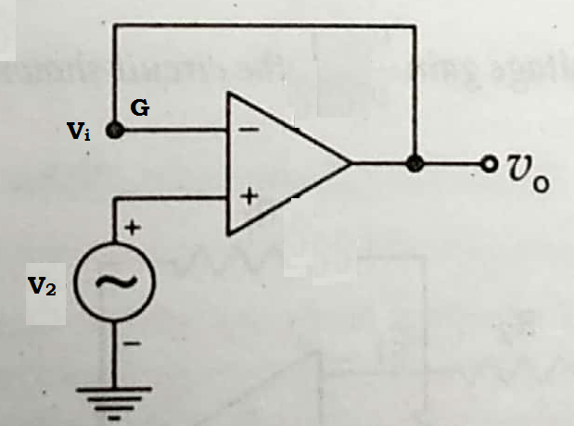
Voltage follower
In this circuit R_{f} = 1,
V₀ = V_{i} = V₂
Voltage gain A_{v} = 1.
Output voltage is equal and in phase with the input and the OP-AMP circuit acts as a voltage follower.
It is also called as source follower, isolating amplifier and buffer amplifier.

Slide 19
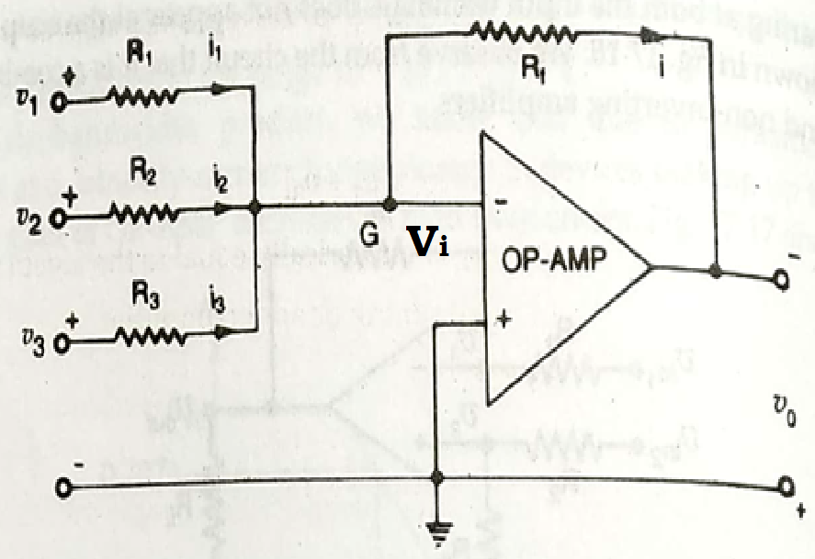
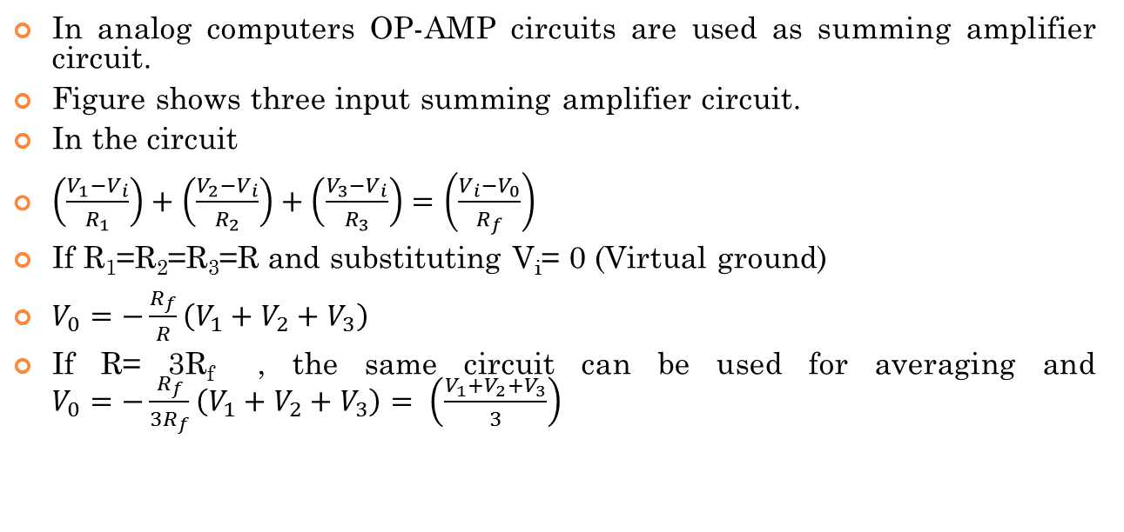
Adder or Summing amplifier:
In analog computers OP-AMP circuits are used as summing amplifier circuit.
Figure shows three input summing amplifier circuit.
In the circuit
$\left(\frac{V_{1}−V_{i}}{R_{1}}\right)+\left(\frac{V_{2}−V_{i}}{R_{2}}\right)+\left(\frac{V_{3}−V_{i}}{R_{3}}\right)=\left(\frac{V_{i}−V_{0}}{R_{f}}\right)$
If R₁=R₂=R₃=Rand substituting V_{i}= 0 (Virtual ground)
$V_{0}=−\frac{R_{f}}{R}\left(V_{1}+V_{2}+V_{3}\right)$
If R= 3R_{f} , the same circuit can be used for averaging and $V_{0}=−\frac{R_{f}}{3R_{f}}\left(V_{1}+V_{2}+V_{3}\right)= \left(\frac{V_{1}+V_{2}+V_{3}}{3}\right)$

Slide 20
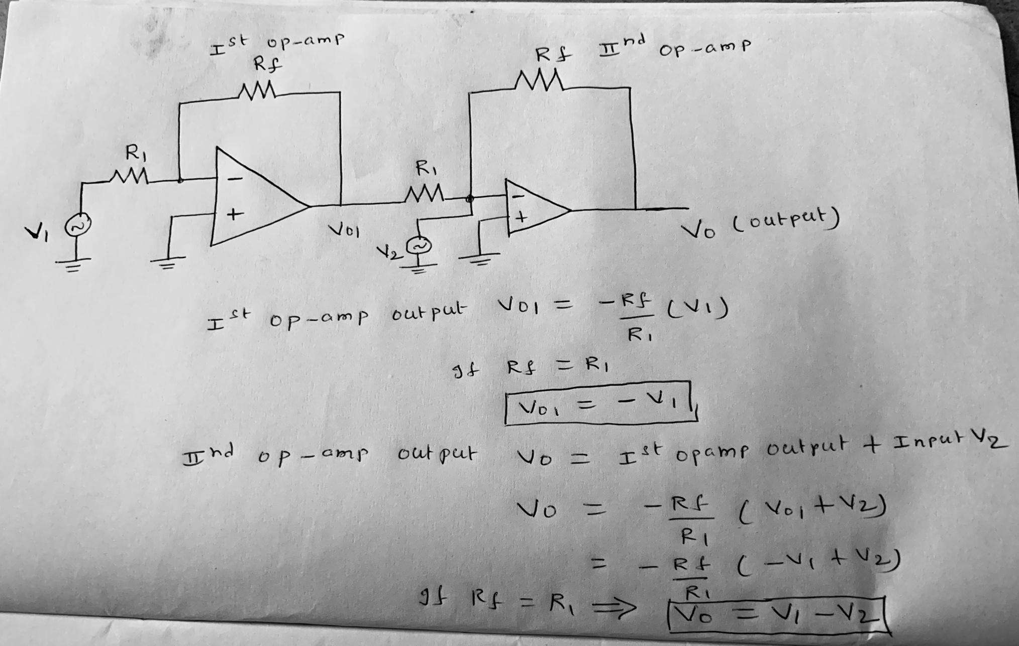
subtractor or difference amplifier with two op-amps

Slide 21
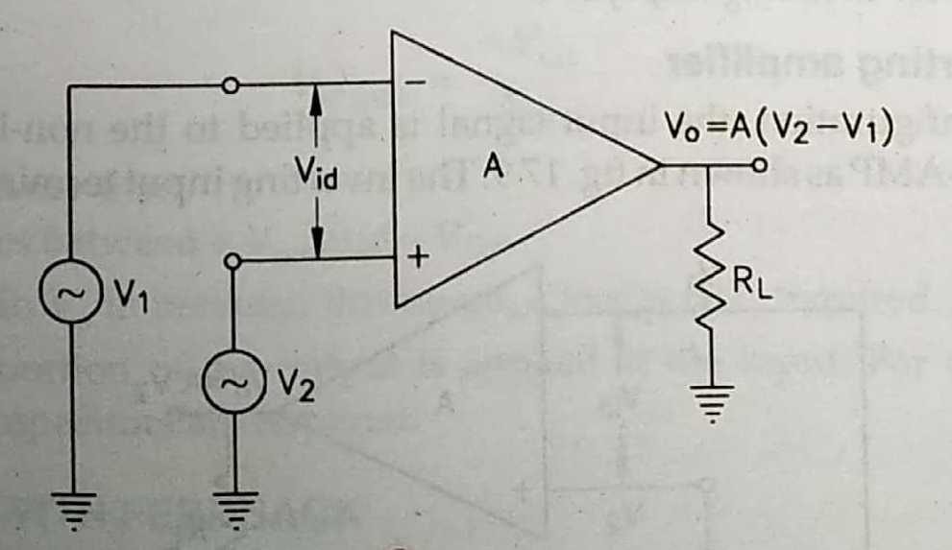
Differential amplifiers: Open loop
A differential amplifier amplifies the difference between two voltages V₁ and V₂ applied at both input terminals.
Their amplified difference appears at the output terminal.
V₀ = A(V₂-V₁)

Slide 22
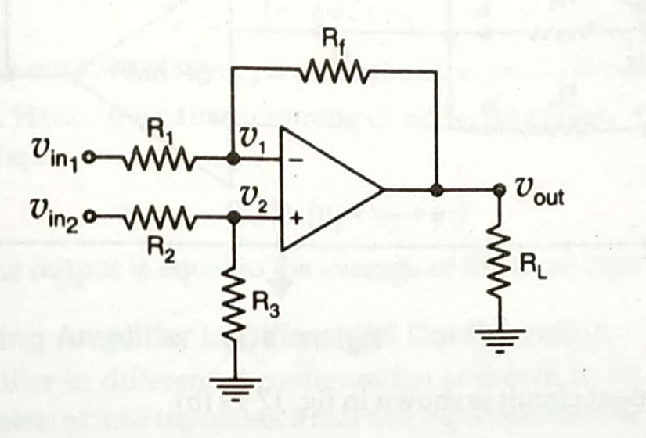
Single Op-Amp Differential amplifier
It is a combination of inverting and non-inverting amplifiers.
To calculate output voltage super position theorem is applied.
V_{out} is equal to sum of the individual responses of V_{in1} and V_{in2}.
i.e V_{out} = V_{out1} + V_{out2}

Slide 23
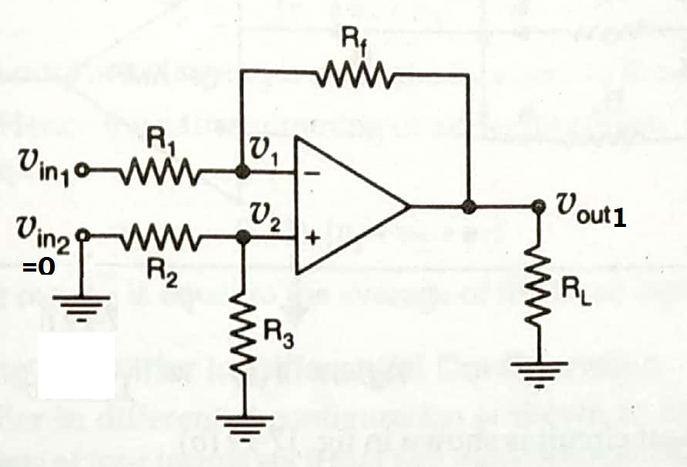
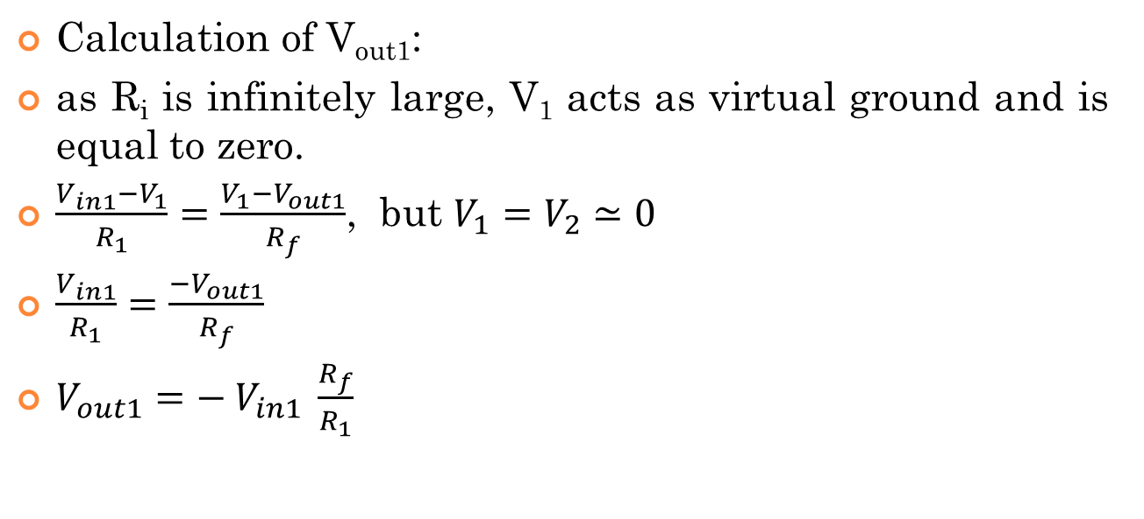
Differential amplifiers: Closed loop
Calculation of V_{out1}:
as R_{i}is infinitely large, V₁ acts as virtual ground and is equal to zero.
$\frac{V_{in1}−V_{1}}{R_{1}}=\frac{V_{1}−V_{out1}}{R_{f}}$, but $V_{1}=V_{2}≃0$
$\frac{V_{in1}}{R_{1}}=\frac{−V_{out1}}{R_{f}}$
$V_{out1}={− V}_{in1} \frac{R_{f}}{R_{1}}$

Slide 24
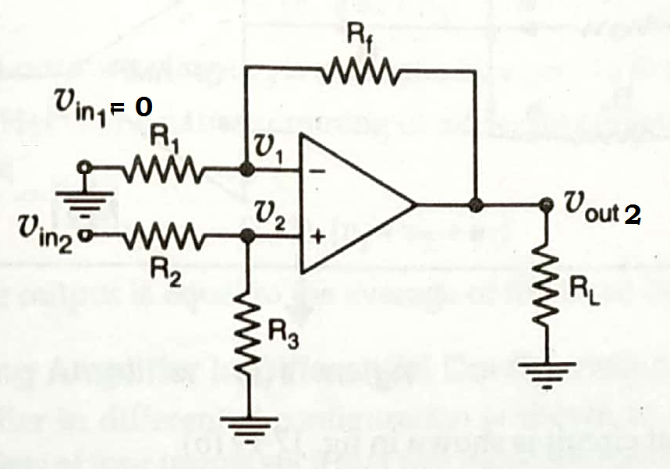
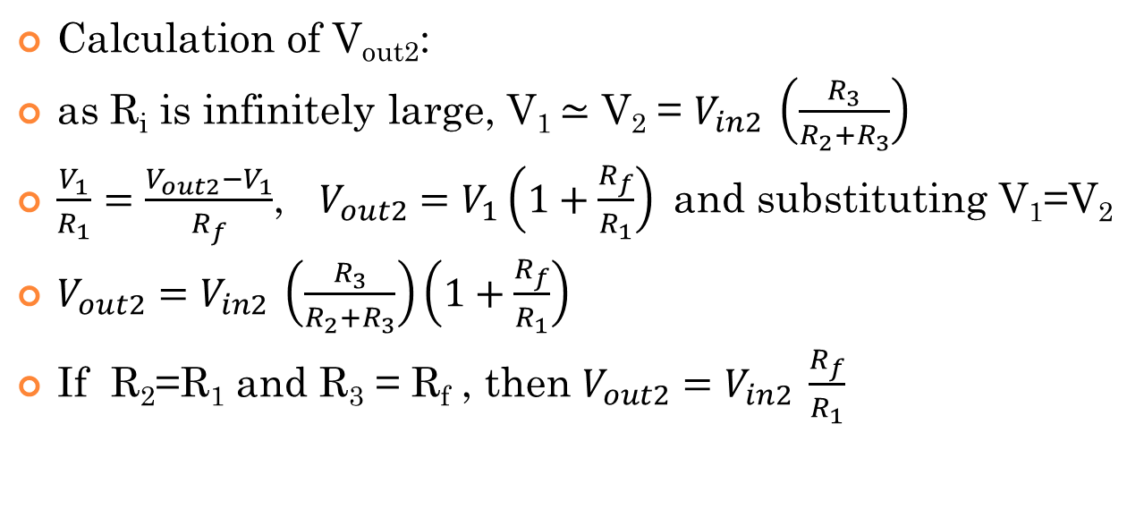
Differential amplifiers: Closed loop
Calculation of V_{out2}:
as R_{i}is infinitely large, V₁ $≃$ V₂ = $V_{in2} \left(\frac{R_{3}}{R_{2}+R_{3}}\right)$
$\frac{V_{1}}{R_{1}}=\frac{V_{out2}−V_{1}}{R_{f}}$, $V_{out2}=V_{1}\left(1+\frac{R_{f}}{R_{1}}\right)$and substituting V₁=V₂
$V_{out2}=V_{in2} \left(\frac{R_{3}}{R_{2}+R_{3}}\right)\left(1+\frac{R_{f}}{R_{1}}\right)$
If R₂=R₁ and R₃ = R_{f}, then $V_{out2}=V_{in2} \frac{R_{f}}{R_{1}}$

Slide 25
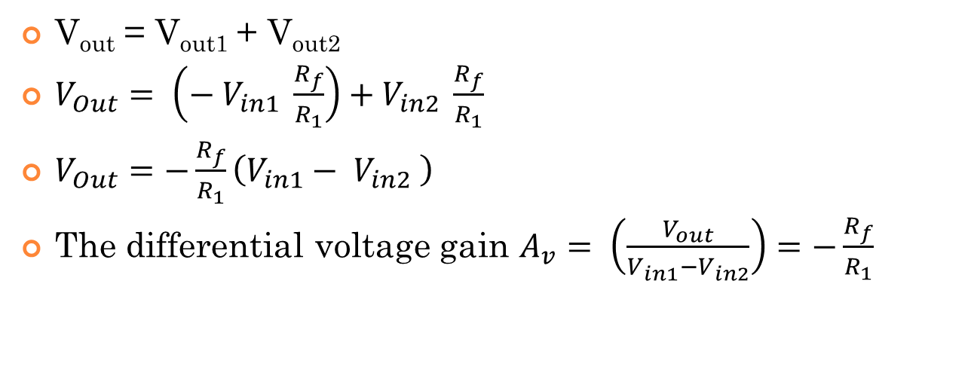
Differential amplifiers: Closed loop
V_{out} = V_{out1} + V_{out2}
$V_{Out}= \left({− V}_{in1} \frac{R_{f}}{R_{1}}\right)+V_{in2} \frac{R_{f}}{R_{1}}$
$V_{Out}=−\frac{R_{f}}{R_{1}}\left({V_{in1}− V}_{in2} \right)$
The differential voltage gain $A_{v}= \left(\frac{V_{out}}{V_{in1}−V_{in2}}\right)=−\frac{R_{f}}{R_{1}}$

Slide 26
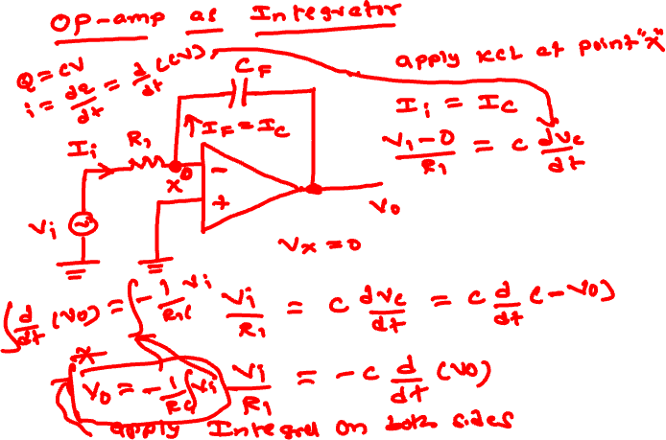

Slide 27
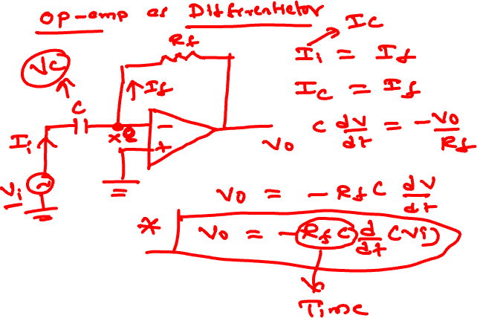

Slide 28
Applications of OP-AMP
Wave form Convertor
Oscillator
Active Filter
Voltage Comparator
Analog to Digital Convertor (ADC) & Digital to Analog Convertor (DAC)
Integrator
Differentiator
Voltage follower
Adder
Subtractor

